Slide 1

Trends in World Energy: Preliminary Projections from the International Energy Outlook 2003
Linda E. Doman
Energy Information Administration
March 18, 2003

Slide 2
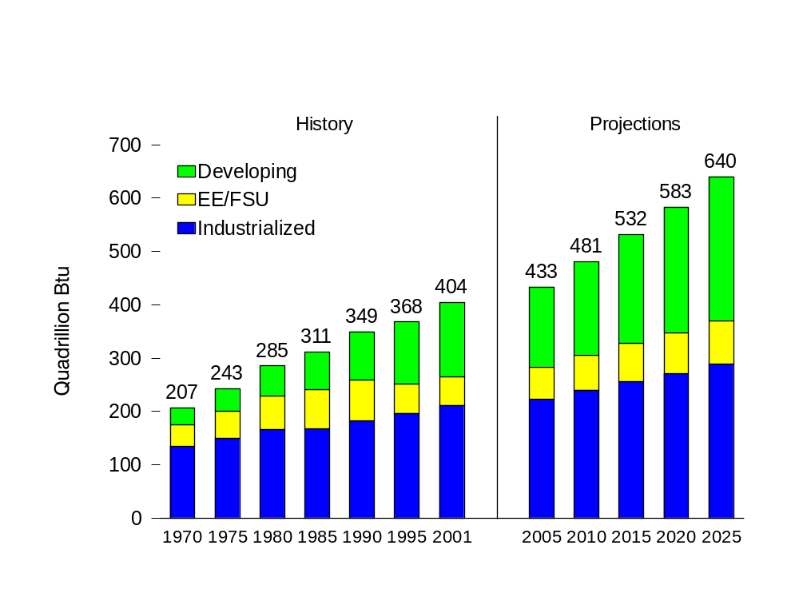
Preliminary World Energy Consumption, 1970-2025
Source: EIA, System for the Analysis of Global Energy Markets (2003)

Slide 3
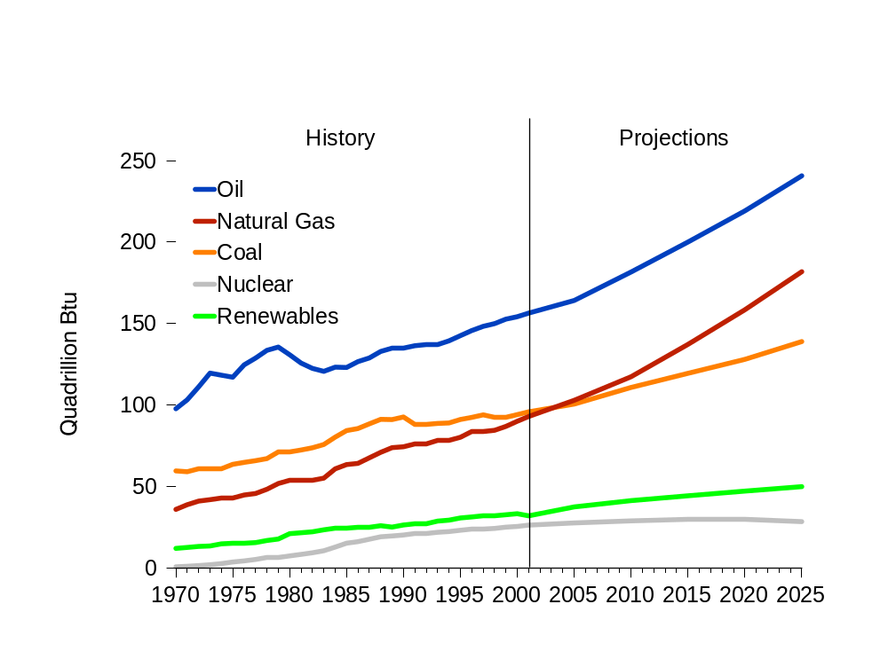
Preliminary World Energy Consumption by Fuel Type, 1970-2025
Source: EIA, System for the Analysis of Global Energy Markets (2003)

Slide 4
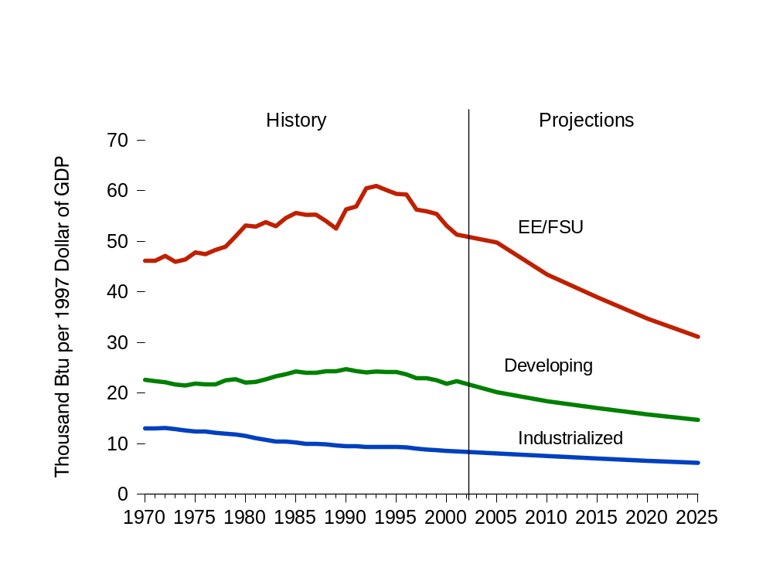
Preliminary Energy Intensity by Region, 1970-2025
Source: EIA, System for the Analysis of Global Energy Markets (2003)

Slide 5
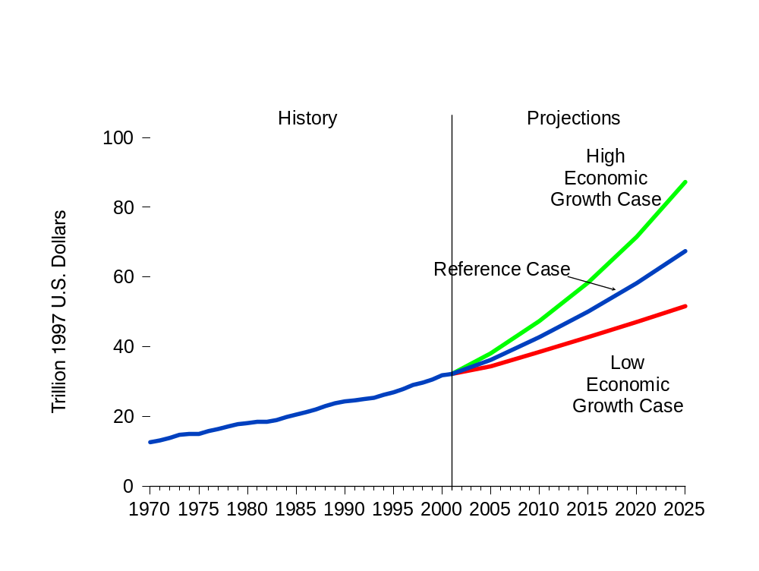
Preliminary World Gross Domestic Product in Three Economic Growth Cases, 1970-2025
Source: Global Insight, Inc. World Economic Outlook, Vol. 1 (Lexington, MA,
Third Quarter 2002); and System for the Analysis of Global Energy Markets (2003)

Slide 6
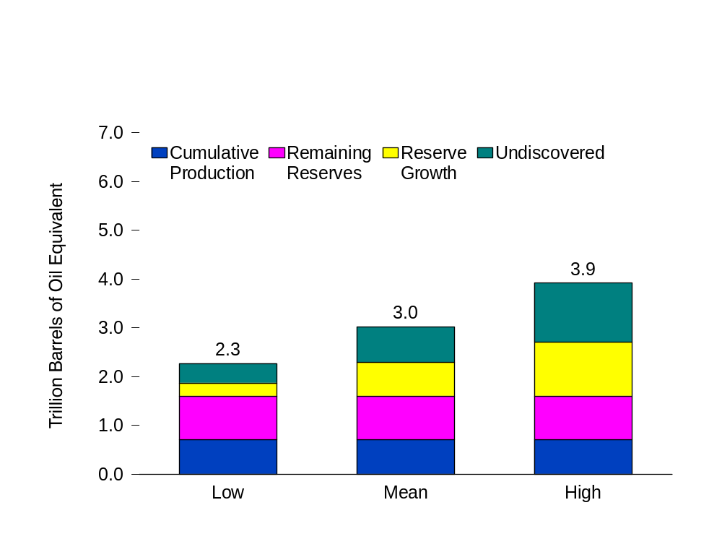
Conventional World Oil Resources, 1995-2025
Source: US Geological Survey, World Petroleum Assessment 2000

Slide 7
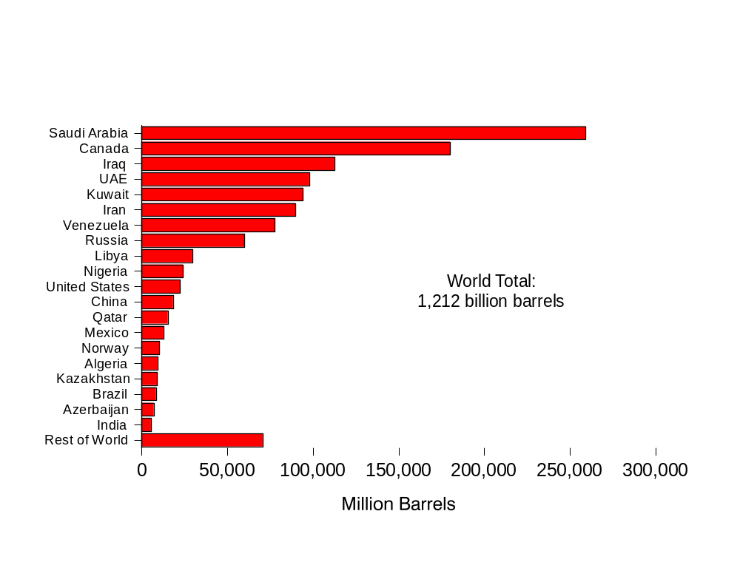
World Oil Reserves by Country, as of January 1, 2003
Source: "Worldwide Look at Reserves and Production."Oil & Gas Journal,
Vol. 100, (December 23, 2003), pp. 114-115.

Slide 8
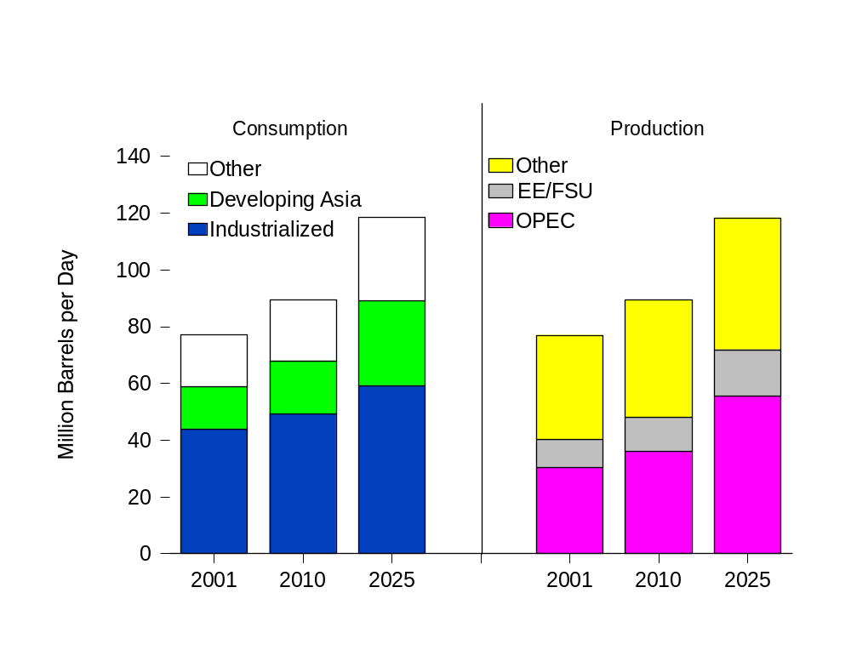
Preliminary World Oil Consumption and Production, 2001, 2010, and 2025
Source: EIA, System for the Analysis of Global Energy Markets (2003)

Slide 9
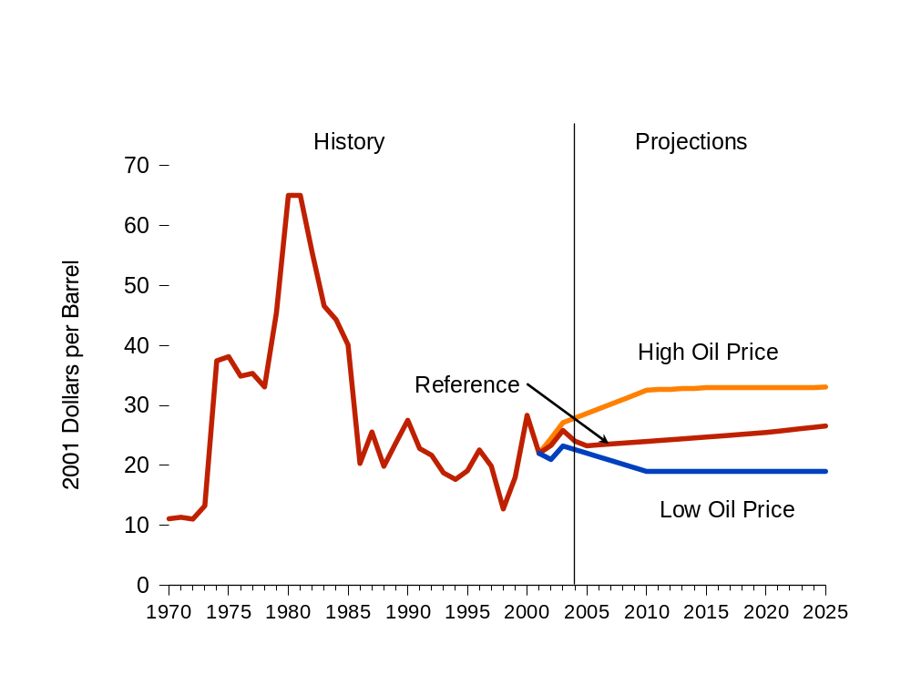
Preliminary World Oil Prices in Three Cases, 1970-2025
Source: EIA, System for the Analysis of Global Energy Markets (2003)

Slide 10
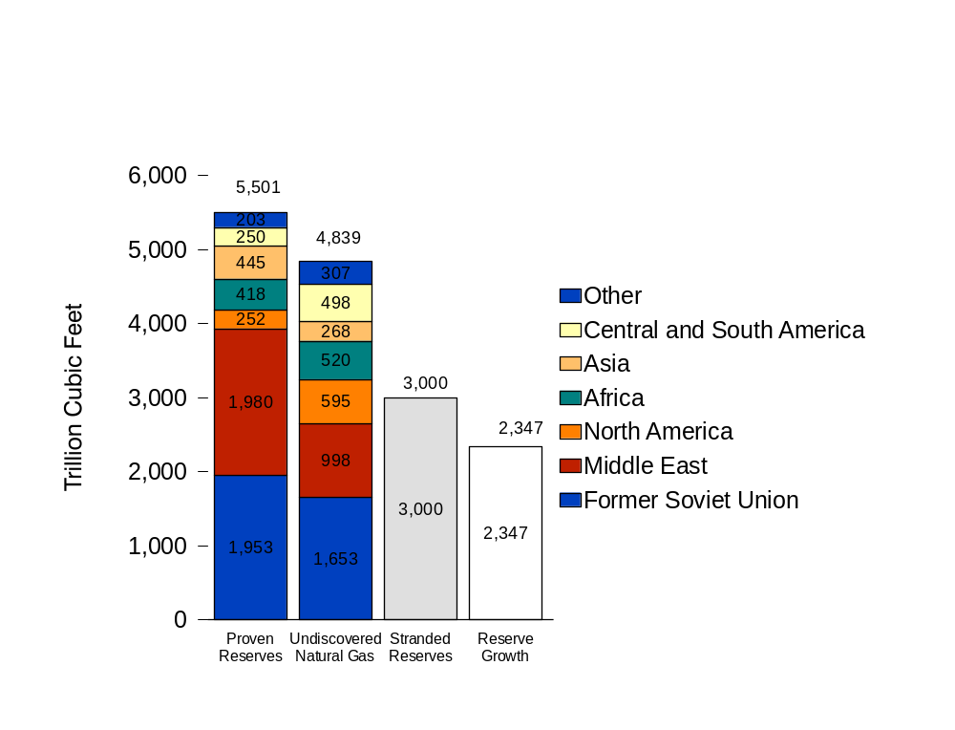
World Natural Gas Resources as of January 1, 2003
Source: US Geological Survey, World Petroleum Assessment 2000

Slide 11
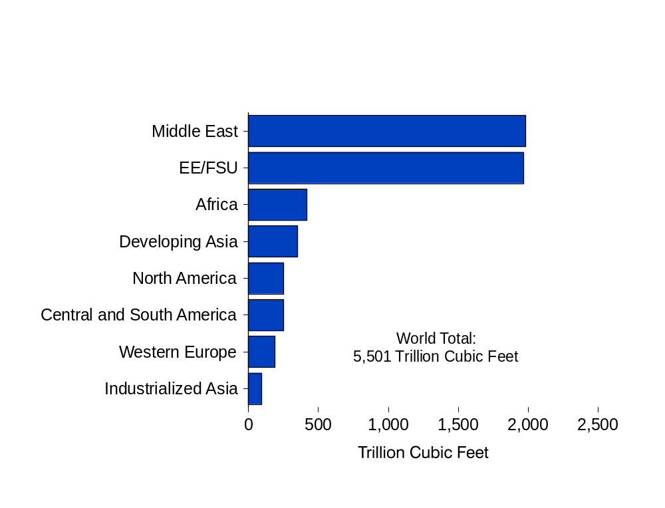
World Natural Gas Reserves by Region, as of January 1, 2003
Source: "Worldwide Look at Reserves and Production," Oil & Gas Journal,
Vol. 100, No. 52, December 23, 2001, pp. 114-115.

Slide 12
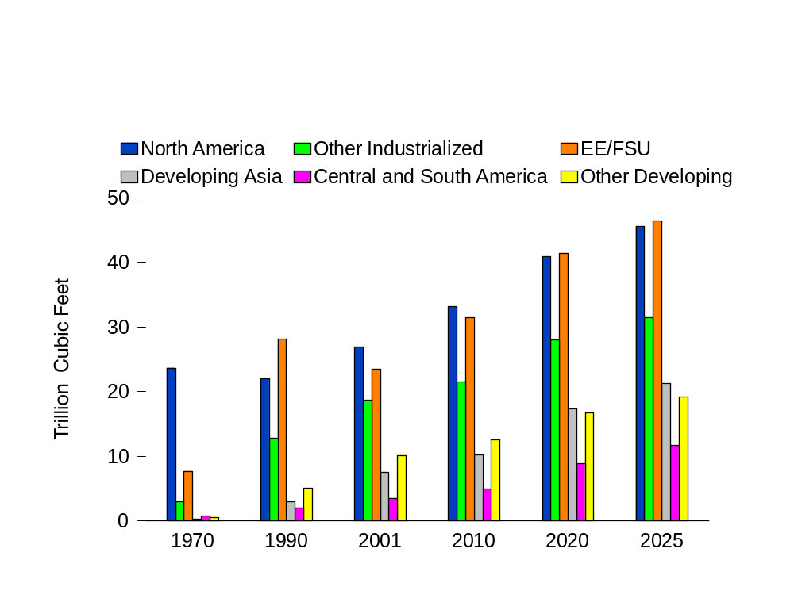
Preliminary World Natural Gas Consumption by Region, 1970-2025
Source: EIA, System for the Analysis of Global Energy Markets (2003)
Notes:
In the IEO2003 reference case, natural gas consumption in 2020 is projected to total 162 trillion cubic feet, nearly double the 1999 total of 84 trillion cubic feet, and its share of total energy consumption is projected to increase from 23 percent in 1999 to 28 percent in 2020.
The growth in natural gas consumption in developing countries is expected to be significantly greater than in the rest of the world, averaging 5.3 percent per year, as compared with 2.4 percent per year in the industrialized countries, 1.9 percent per year in the EE/FSU, and 3.2 percent globally. In the developing countries, annual natural gas use is projected to almost triple over the forecast period. The largest increments in natural gas use are expected in developing Asia and the Middle East.
Much of the projected growth in natural gas consumption throughout the world is in response to rising demand for natural gas to fuel efficient new gas turbine power plants. In the IEO2003 reference case, the projections for natural gas consumption by electricity generation show more rapid growth than the projections for any other fuel. Although coal is expected to remain the predominant fuel used for power generation, by 2020 natural gas is projected to capture 23 percent of the power generation in the industrialized world compared to 16 percent in 1999; and 21 percent in the developing world compared to 6 percent in 1999.

Slide 13
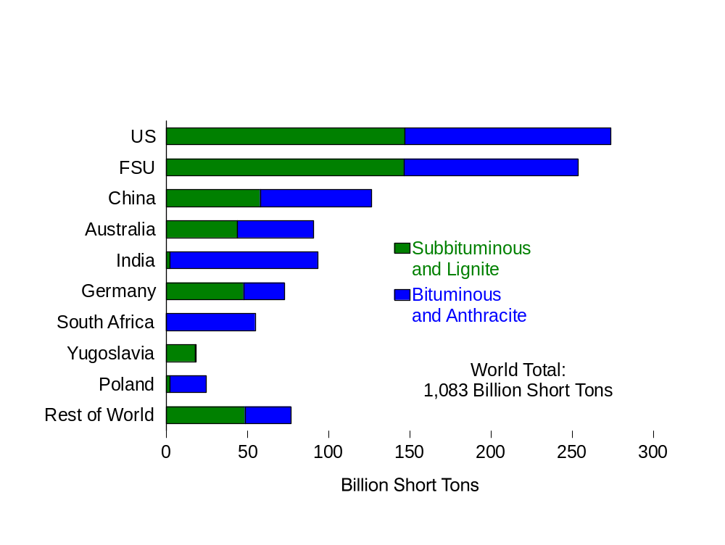
World Recoverable Coal Reserves as of January 1, 2001
Source: EIA, International Energy Annual 2000

Slide 14
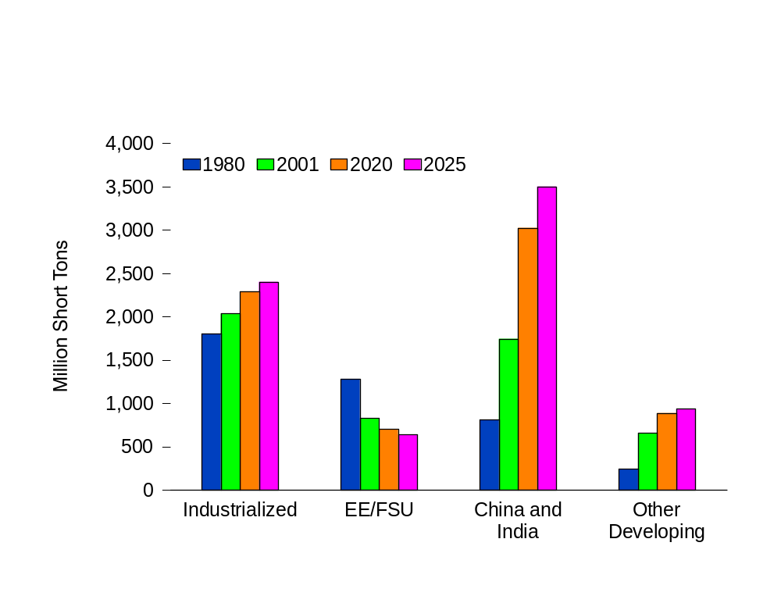
Preliminary World Coal Consumption by Region,
1980, 2001, and 2025
Source: EIA, System for the Analysis of Global Energy Markets (2003)

Slide 15
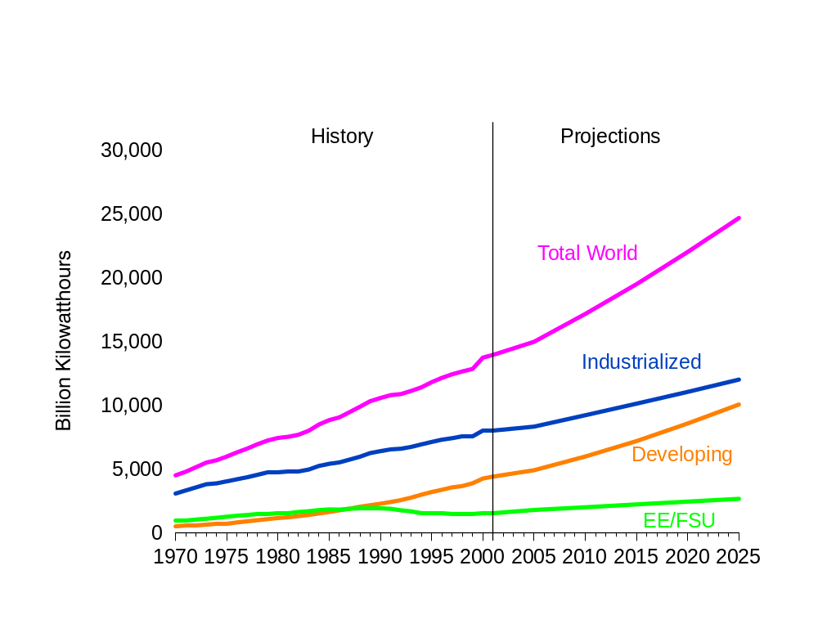
Preliminary World Net Electricity Consumption by Region, 1970-2025
Source: EIA, System for the Analysis of Global Energy Markets (2003)

Slide 16
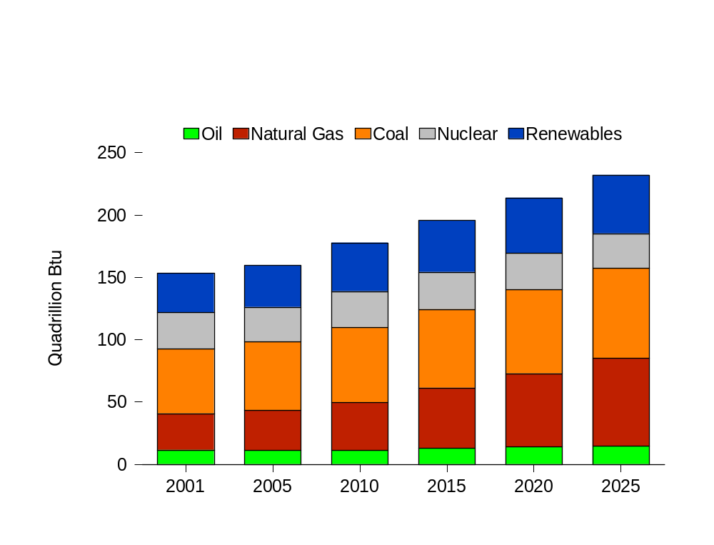
Preliminary Energy Used for Electricity Generation by Fuel, 2001-2025
Source: EIA, System for the Analysis of Global Energy Markets (2003)

Slide 17
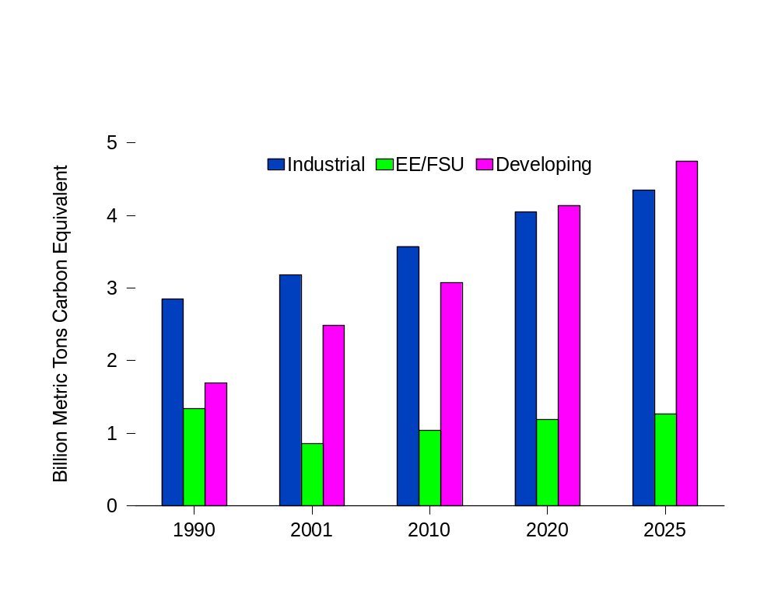
Preliminary World Carbon Emissions by Region,
1990-2025
Source: EIA, System for the Analysis of Global Energy Markets (2003)

Slide 18
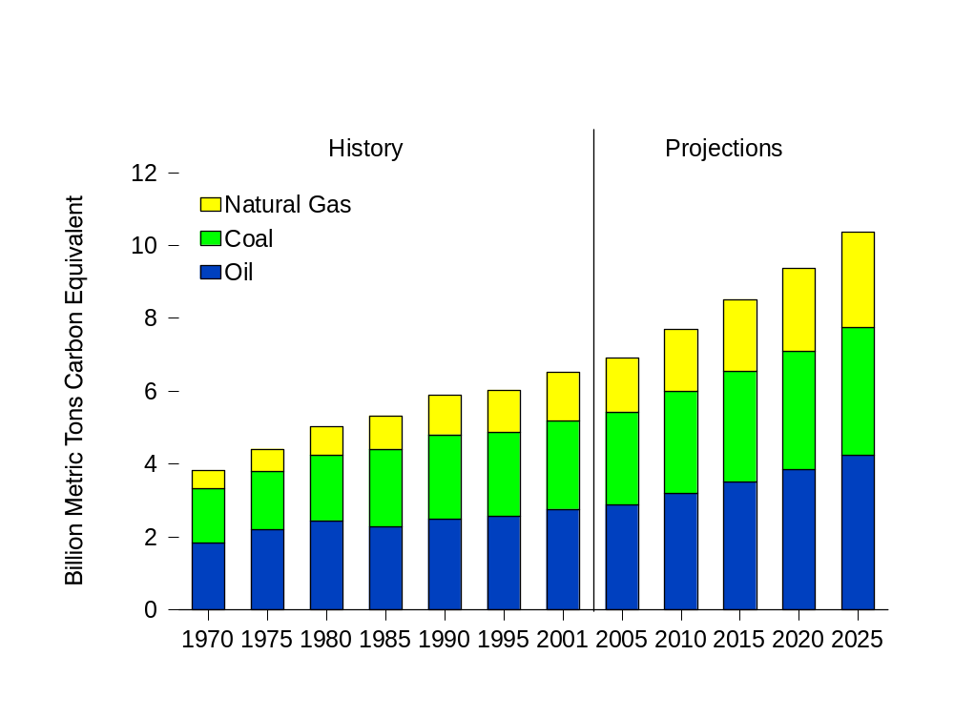
Preliminary World Carbon Emissions by Fossil Fuel Type, 1970-2025
Source: EIA, System for the Analysis of Global Energy Markets (2003)

Slide 19
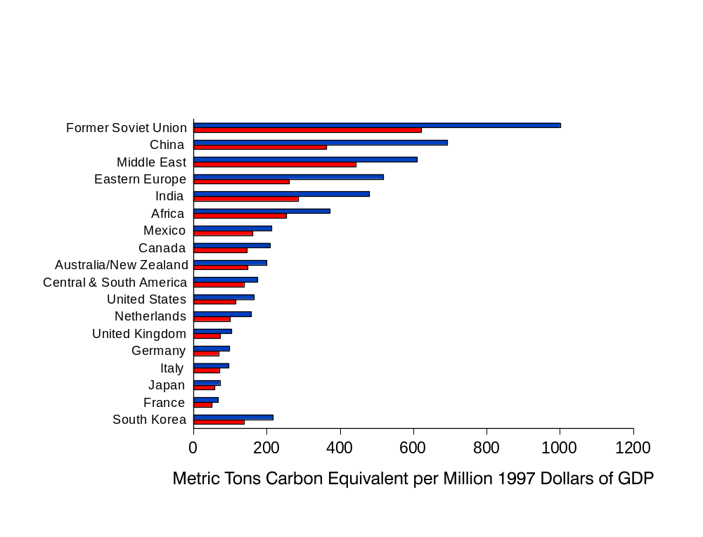
Preliminary Carbon Intensity for Selected Countries and Regions, 2001 and 2025
Source: EIA, System for the Analysis of Global Energy Markets (2003)

